Slide 1
NLP: Fake News Predictor
By:
Michael Delcid
Gurpreet Singh
CPE 608 WS - Applied Modeling & Optimization
Fall 2022

Slide 2
Problem Description
Humans are bombarded with loads of information every single day. Information is easily accessible through the palm of our hands and often times it is difficult to discern valid news outlets from “fake news”. Studies have shown that many Americans can’t tell what news is fake and what news is real. A real life example of this can be traced back to the 2020 Presidential Election. Fake news creates confusion and misunderstanding about social and political issues within a population. It ultimately affects a person’s judgement and their ability to see the truth.
In this proposal, we will attempt to classify whether or not a news article excerpt is real or fake by using a variety of machine learning techniques.

Slide 3
Optimization Model
In order to solve this problem, we used a variety of different techniques to arrive at our final solution. The machine learning models we used are:
Decision Tree Classifier
Naive Bayes
Random Forest Classifier
Logistic Regression
Support Vector Machine
Artificial Neural Network
By using different machine learning techniques within the Tensorflow, python Sklearn and NLTK (Natural Language Toolkit) libraries, we improved the accuracy of our models.

Slide 4
Proposed Solution
Our proposed solution consisted of fine tuning a wide range of machine learning algorithms, specifically classifiers. In order to achieve this goal, a large dataset is required, which was found on Kaggle. Considering the nature of the data, the proposed solution is non-convex. The data cannot be fit in with a singular function. As such, we also have an infeasible set. What we are looking for is the best solution possible, as a solution that fits all data points would be considered over-fitting. This means, by our definition, a solution exists, but it may not be practical depending on the results.
We need to find a way to correctly and accurately predict if a news article is genuine or not. For our solution, we found that supervised algorithms such as Naive Bayes, SVMs, and Random Forest Classifiers are the best to use when creating a model that can be generalized a diverse dataset. It is difficult to categorize textual data, as we found when tuning our neural network, which is why we decided to use these types of algorithms.

Slide 5
Proposed Solution
Steps for classification:
Data processing
Drop unused data columns
Merge true and false data, adding 1 for true and 0 for false in another column
Data Cleaning
Shuffle data to prevent overfitting
Convert all characters to lowercase
Remove punctuation
Remove stopwords
For neural network, tokenize words and pad sequences into array
Implement Classification Algorithms
Create confusion matrices to better understand results

Slide 6
Validating Solution
The first step we took in validating our dataset was to assign a label of 1 to the real dataset and a 0 to the fake dataset. Both datasets were combined into one large dataset by concatenating them and then randomizing the dataset. The result was a random mix of real and fake data. The data was then cleaned by stripping punctuation from the articles followed by changing all characters to lowercase. Each word was then tokenized using the NLTK library.
The dataset was then split into a test and train dataset with 20% of total data going into the test set. A majority would be used to train each model. From here, fitting the training data into the set is crucial to correctly predict the test set. Often, additional data transformation is needed to complete this such as vectorization, tokenization, bag-of-words, etc., because our data is a string and we must use floats to complete the fitting process.
Finally, we get to predict the results using the accuracy score function (for classifiers), where we compare predicted set to our labels of 1’s and 0’s and see what matches. A confusion matrix is plotted for additional visualization.
For a neural network, the important thing is to not overfit and to optimize the model itself (i.e. layers, hidden layers). There was much testing done, but the conclusion was to use an Embedding layer and connect it to a Dense layer. But to do that we must flatten the data. Once that was done, we experimented with dropping nodes, batch normalization, and additional parameters for the optimal solution.

Slide 7
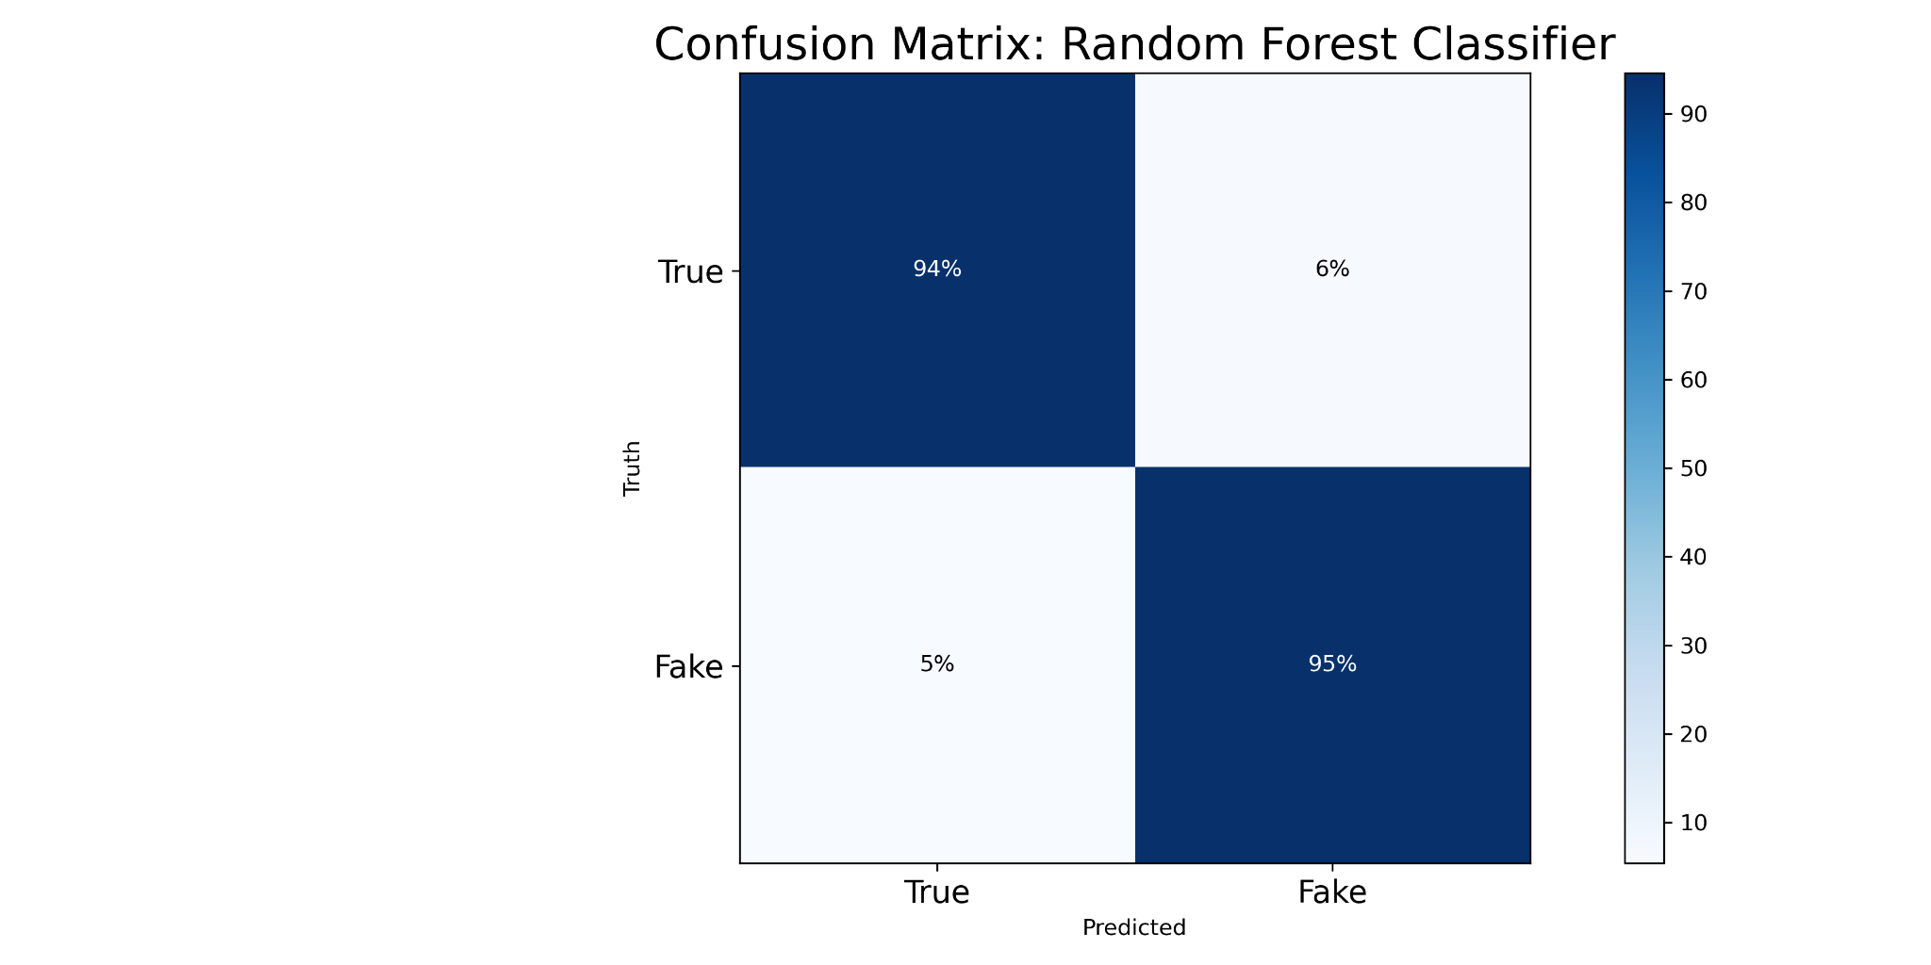
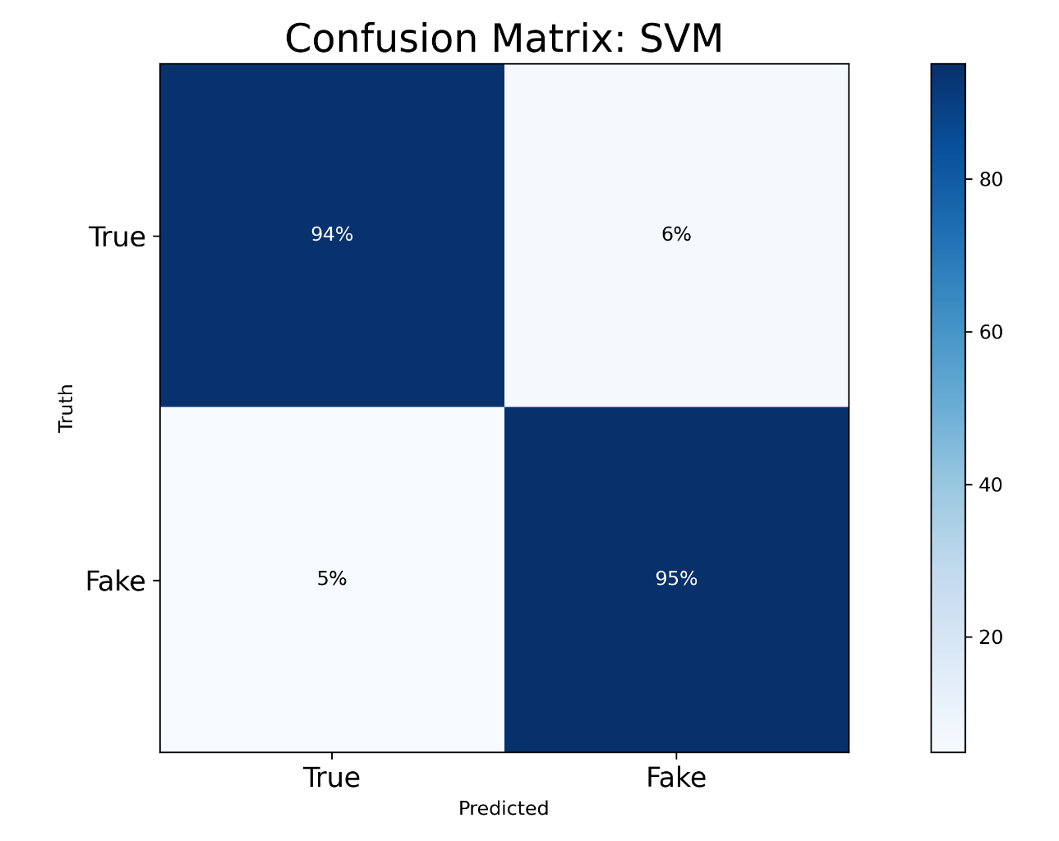
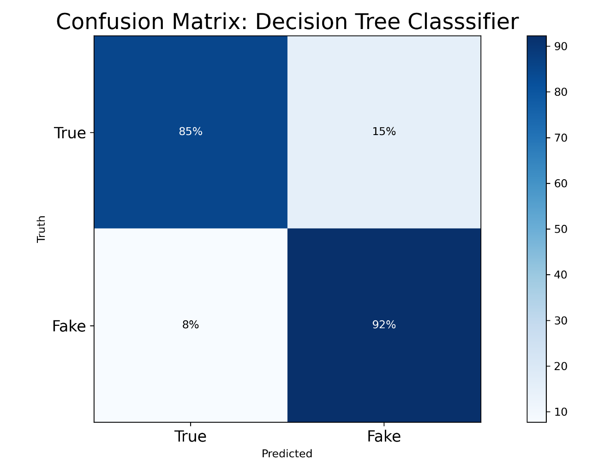
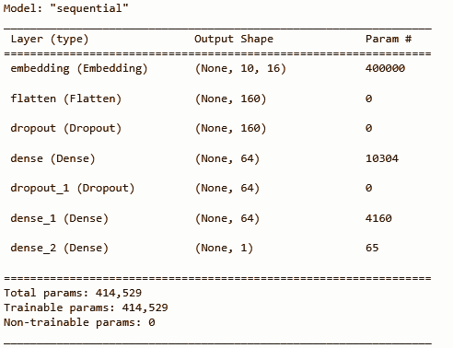
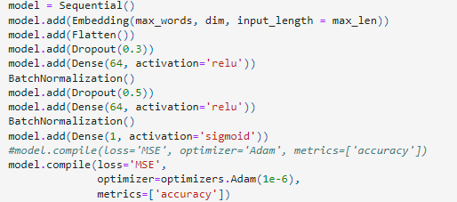
Validating Solution
Confusion Matrix Outputs:
Neural network layers

Slide 8
Key Insights
In terms of the classification models, achieving an accuracy of 90+% with several models including SVM, Random Forest Classifier, and Naive Bayes is a great accomplishment. This means that if we clean the data and input it into our model, we have a high degree of certainty that the model will classify a news article as real or fake correctly. We found that Logistic Regression was the worst built in model to use from sklearn to use in a Natural Language Processing task such as this. On the other hand, a linear model such as SVM has the ability to generalize new data well in high dimensional spaces, and served well in this experiment. SVM models eliminate the need for feature selection, making the application of text categorization significantly easier. The other well-performing models are non-linear, which makes sense given the nature of the data.
We’ve observed that results vary depending on the cleaning process of the data. Adding additional data processing such as vectorization or lemmatization can hurt the model performance.
Surprisingly, the worst performing algorithm was the neural network. This may be due to a lack of knowledge from us about neural networks. As in, there must be a way to optimize the neural network better with its layers, optimizer functions, or fitting. However, this can also be due to a lack of data.

Slide 9
Major Conclusions
Our approach is viable to only classifying news articles as real or fake. This approach could be used for other classification problems, but might get difficult with multiple options to classify to. May need to use PCA in that case. The neural network approach is not viable to predict a fake vs a true article, however. This was experimented in the code, and it turns out to be a coin toss.
The main difficulties we ran into was tokenizing words. Normalizing the data is a challenging enough and slight differences in a word, or related words, can drastically affect our results. As an example, when we attempted to remove stopwords, some sentences were incomprehensible. This combined with lemmatization was not a good idea at first, but after optimizing the code, it became better. The other difficulty was creating a viable neural network solution. This required more time to properly perform.

Slide 10
Suggestions for Improvement
If we had more time, the first step we’d take is attempt to derive the underlying mathematical formulas used in the python libraries ourselves. We feel that having the ability to derive the equations ourselves, and validating them against the theory shown in class, would give us greater confidence in our model. It’ll also give us the ability to own the intellectual property of the algorithms we develop to one day create a startup company that specializes in classifying news articles. A long term goal would be to deploy the machine learning model into an application like Twitter if the hopes of recognizing if an account is genuine or not, considering the new check mark approach by Elon’s Twitter.
Finally, we believe that there is promise in implementing a great neural network to predict the truthness in news articles, so having that will greatly increase our project’s performance.

